Slide 1


Halil Ibrahim Uluoglu

Slide 2

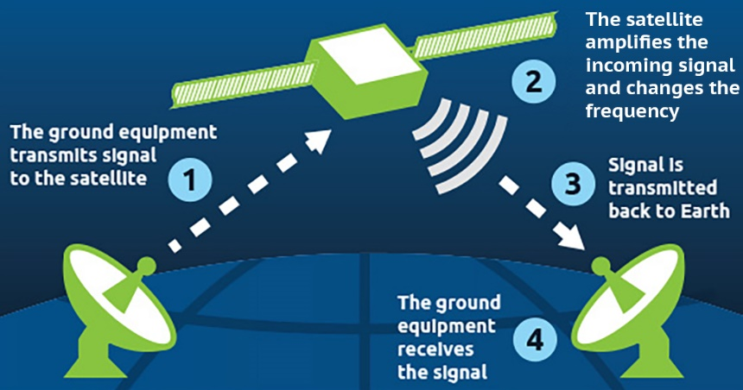
Problem Document
Requirement
Shall allow experts on Earth who are not physically in the same space to collaborate and develop instructions for astronauts
Author
Halil Ibrahim Uluoglu, UEF
Description
Giving instruction from Earth to astronauts is one of the most important mission during Mars exploration. It can be considered 4 steps to manage this problem.
Understanding what is the problem from astronauts
Considering that astronauts are not experts in the problem, they may not know technical details to describe for experts on Earth. So, it can cause some extra problems except just understanding the main problem
Solving the problem with experts on Earth
Even tiny problems at the Mars must always considerate as fatal problems because of Mars conditions. Experts must be gathered very quickly to save time and they must have a working single exact solution in order not to cause misunderstandings. Experts should have as the same environment as astronauts have.
Transferring solution to astronauts
Communication is a very challenging situation even two places on Earth because of weather conditions, it may disrupt. Also, antennas on Earth and satellite of astronauts must lock at the same angle during transferring messages considering that satellite and Earth spin duration and speed. Therefore, communication channels should be solid and messages should be pure.
Apply solution to the problem
Astronauts might have just one chance to apply the solution. So, the solution package should cover all significant details with basic understanding. The package also should include the purpose of that movement hence astronauts understand information about what is happening also they can interfere in an emergency
Simulation/Measurement
Prepare same condition as astronauts have before the problem
Simulate a communication method and test with same difficulties
Instruction with Keywords
References
https://spaceplace.nasa.gov/sound-cone/en/
https://spaceplace.nasa.gov/dsn-antennas/en/
https://www.nasa.gov/sites/default/files/files/NASA-Solve-FS.pdf

Slide 3
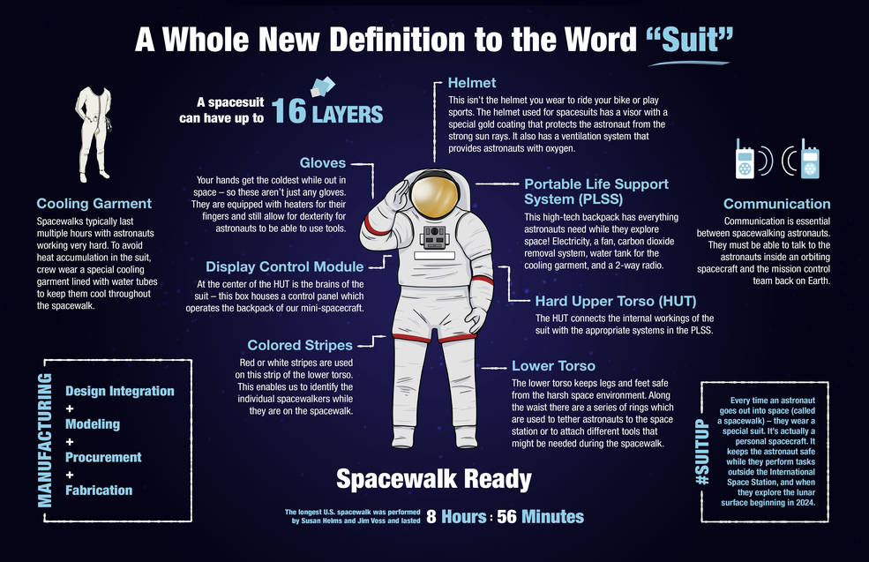
Problem Document
Sub-problem
Solution Instruction Developing
Author
Halil Ibrahim Uluoglu, UEF
Description
Even tiny problems at the Mars must always considerate as fatal problems because of Mars conditions. Solutions which developed on Earth may not fit unique Mars conditions. Mars contains extreme low temperature, no breathable air, high risk radiation and changeable magnetic fields. Moreover, radiation and magnetic field is very dangerous for computers in space crafts. When radiation collides with electronic circuit, they can cause spurious currents around the craft or even burn out computer chips. Changeable magnetic field can induce the content of memory cells so, it may cause different bits in memory. It may cause even collapse.
Experts must be gathered very quickly to save time and they must have a working single exact solution in order not to cause misunderstandings. So, while experts developing a solution, they should consider every possibility that may happen. Some steps may cause problems not in the moment but during the time.
Experts and astronauts can not make a video conference every time due to communication difficulties. In order to come up with a solution, they should have to access all specific, tiny details. So, they should have the same environment as astronauts have.
For these reasons, they need to prepare well-designed instructions that both experts and non-experts can understand/apply without any difficulties. Instruction should contain visual content for better understanding, some technical details for future perspective, flow charts for algorithmic solutions and also the purpose of that movement hence astronauts understand information about what is happening also they can interfere in an emergency.
Simulation/Measurement
Prepare same condition as astronauts have before the problem
Simulate a communication method and test with same difficulties
Instruction with Keywords
References
https://www.esa.int/Science_Exploration/Space_Science/Extreme_space/Surviving_extreme_conditions_in_space
https://www.cobblestonelearning.com/10-design-tips-instructional-designers/
https://www.nasa.gov/feature/spacewalk-spacesuit-basics

Slide 4
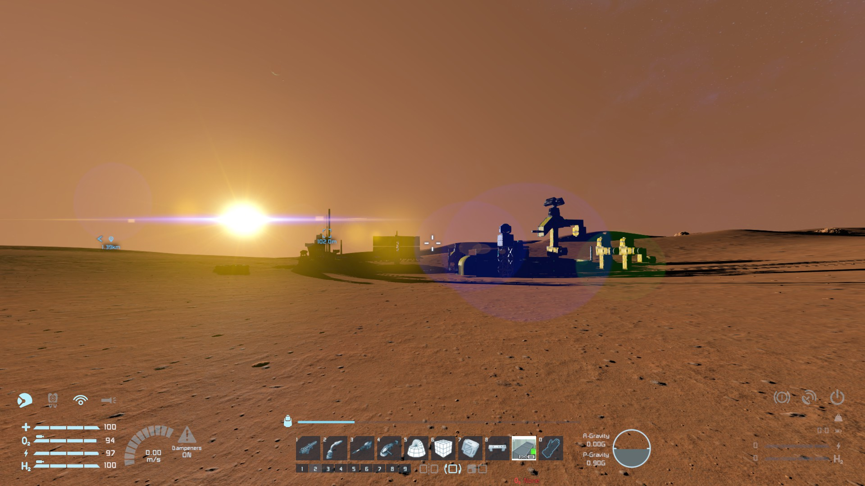
Existing Reference Idea Document
Problem and Idea Title
Solution Instruction Developing - Simulations
Author
Halil Ibrahim Uluoglu, UEF
Description
Mars has very rough conditions for human beings. It is very fatal compare to our planet Earth. As human-beings , we increase our knowledge about Mars and its unique conditions. However, It is still hard to predict all problems can happen. Fortunately, we can provide a solution with some techniques to fix immediately unpredictable problems. One of the solution developing method is simulations.
Within simulations, we can create -at least with our knowledge- as same as conditions that Mars has. Nasa has unique simulations environments for solution instruction developing.
Bigelow Expandable Activity Module: Expandable habitat technology for astronauts.
Space Launch System/Orion Crewed Spacecraft/Space Launch Complex: Ensuring transportation capability for Mars missions and other challenging missions.
Asteroid Redirect Mission: Improving solar energy systems for the journey to the Mars.
Deep Space Network/Near Earth Network/Space Network: Significant communication tools for humans and robotic participants.
Rovers: Nasa sends vehicles to discover and develop instructions for can cause problems. Mars Exploration Rover, Perseverance, Curiosity, Insight Lander, Mars 2020, etc.
SimLabs: Developing new space shuttle vehicles.
Hi-Seas(Hawaii Space Exploration Analog and Simulation): Analog habitat for our journey to the Mars in Hawaii.
Instruction with Keywords
References
https://www.nasa.gov/press-release/nasa-releases-plan-outlining-next-steps-in-the-journey-to-mars
https://mars.nasa.gov/mer/
https://www.nasa.gov/simlabs/simulate-future-space
https://en.wikipedia.org/wiki/HI-SEAS

Slide 5
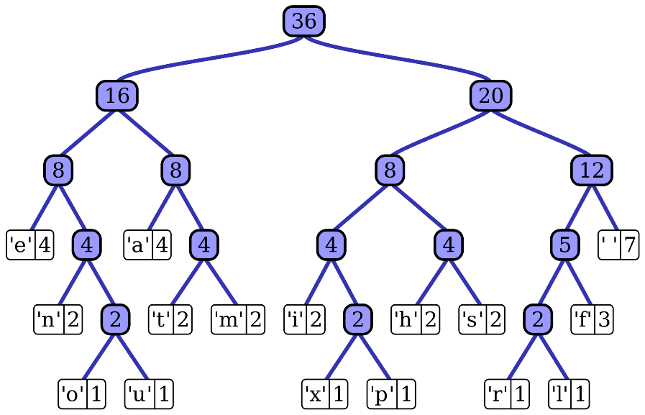
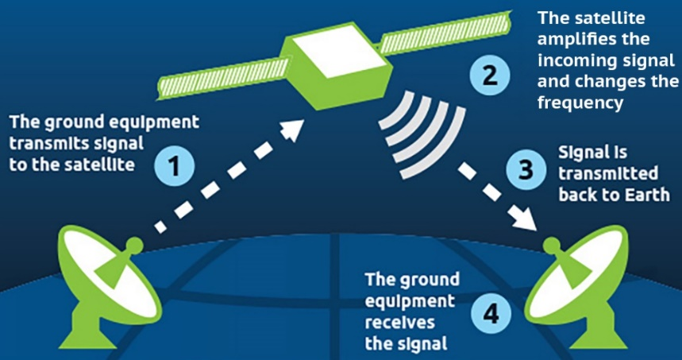
Idea Document
Instruction with Keywords
Sub-problem
Solution Instruction Developing
Author
Halil Ibrahim Uluoglu, UEF
Description
The Communication method is highly important for sending solutions from Earth to the astronauts on Mars. All communication between Mars and Earth can happen with satellite. The minimum distance from the Earth to Mars is about 54.6 million kilometers(not often). Because of this enormous distance between Earth and Mars, a considerable delay signal happens between two planets even signal has the speed of light. It can take 3 to 22 minutes to reach a signal. Also considering the reply of the signal it can take a while for communicate.
Such this case, the information /solution instructions which you send is highly significant.
At this point, my idea is to use compression algorithms to send voice messages to the astronauts. There are methods for compression the file such as Huffman Coding, Elias Code, Unary Coding, SimHash, Parity Check Matrix, etc. The most well-known and efficient algorithm is Huffman Coding.
Huffman Coding: The Huffman Algorithm is a compression algorithm that represents the most used characters with shorter bits and the least used characters with longer bits. For instance, let’s accept a word like “aaaaaaaccs”. Structure of computer we represent 1 letter with 1 byte. So this word is 10 bytes long in computer memory. Instead of using, 10 byte long word we can represent (most used)a -> 0, s -> 10 c -> 11 . So, to represent our word we just need 7a*1bit + 2c*2bit + 1c*2bit = 12 bit which it is just 2 bytes long in the memory. So we applied a %80 reduction to our speech.
For solution instructions, we can record voice and apply this algorithm to our voice and reduce to file size. Then, we can send this file via satellite to the astronauts. The astronauts can use a special program which installed before their computers can convert to compressed file into a regular voice message. So, The time for instruction can efficiently reduce.
References
https://mars.nasa.gov/all-about-mars/night-sky/close-approach/
https://www.mars-one.com/faq/technology/how-does-the-mars-base-communicate-with-earth
https://www.geeksforgeeks.org/huffman-coding-greedy-algo-3/
https://en.wikipedia.org/wiki/Data_compression
https://www.mars-one.com/faq/technology/how-does-the-mars-base-communicate-with-earth

